Slide 1

HEART DISEASE PREDICTION
RNS INSTITUTE OF TECHNOLOGY
BENGALURU - 98
DEPARTMENT OF INFORMATION SCIENCE & ENGINEERING
Presentation on Internship
Tanvi Prasad
USN: 1RN18IS113
New Age Solutions Technologies
Internal Guide
Dr. S Sathish Kumar
Professor, Dept of ISE, RNSIT
External Guide
Mr. Aman Upadhyay
Mentor, NASTECH and Bangalore

Slide 2
AGENDA
Abstract
About the Company
Introduction
Literature Survey
Requirements
System Design
Detailed Design
Implementation
Results
Conclusion and Future Enhancements
References
Q & A

Slide 3
ABSTRACT
The term heart disease, also called cardiovascular disease, encompasses the diverse diseases that affect the heart. The World Health Organization estimates that 12 million deaths occur worldwide every year due to heart disease. It is the major cause of deaths in many developing countries, which proves that heart disease is one of the most dangerous diseases threatening adults lives today.
Heart disease diagnosis is one of the most critical and challenging tasks in the healthcare field. It must be diagnosed quickly, efficiently and correctly in order to save lives. It requires the patient to do many tests, and healthcare professionals must carefully examine the results.
That is why researchers have been interested in predicting heart disease, and they developed different heart disease prediction systems using various machine learning algorithms.

Slide 4
ABOUT THE COMPANY
NASTECH is formed with the purpose of bridging the gap between Academic and Industry.
Nastech is one of the leading Global Certification and Training service providers for technical and management programs for educational institutions.
It collaborates with educational institutes to understand their requirements and form a strategy in consultation with all stakeholders to fulfill those by skilling, reskilling and upskilling the students and faculties on new age skills and technologies.

Slide 5
INTRODUCTION
We analyzed the classification algorithms namely Decision Tree, Random Forest, Logistic Regression and Naive Bayes based on their Accuracy, Precision, Recall and f-measure scores and identified the best classification algorithm which can be used in the heart disease prediction
The proposed work predicts heart disease by exploring the eight classification algorithms and does performance analysis.
The objective of this study is to effectively predict if the patient suffers from heart disease.
The health professional enters the input values from the patient's health report. The data is fed into a model which predicts the probability of having heart disease.

Slide 6
LITERATURE SURVEY
Avinash Golande and et. al. studies various different ML algorithms that can be used for classification of heart disease. Research was carried out to study Decision Tree, KNN and K-Means algorithms that can be used for classification and their accuracy were compared. This research concludes that accuracy obtained by Decision Tree was the highest.
T.Nagamani, et al. have proposed a system which deployed data mining techniques along with the MapReduce algorithm. The accuracy obtained according to this paper for the 45 instances of testing set, was greater than the accuracy obtained using conventional fuzzy artificial neural network.
Fahd Saleh Alotaibi has designed a ML model comparing five different algorithms [3]. Rapid Miner tool was used which resulted in higher accuracy compared to Matlab and Weka tool. In this research the accuracy of Decision Tree, Logistic Regression, Random Forest, Naive Bayes and SVM classification algorithms were compared. Decision tree algorithm had the highest accuracy.
Nagaraj M Lutimath, et al., has performed the heart disease prediction using Naive bayes classification and SVM (Support Vector Machine). The performance measures used in analysis are Mean Absolute Error, Sum of Squared Error and Root Mean Squared Error, it is established that SVM was emerged as superior algorithm in terms of accuracy over Naive Bayes.

Slide 7
REQUIREMENTS
Hardware Requirements
Memory: 8 GB or 4GB
Graphics Card: AMD Radeon RX 480 or NVIDIA GeForce GTX 970
CPU: Intel Core i5-4590
File Size: 2 GB
OS: Windows 7 SP1
Software Requirements
Application: Google CoLab
Dataset: UCI Heart Disease Data Set
Language: Python

Slide 8
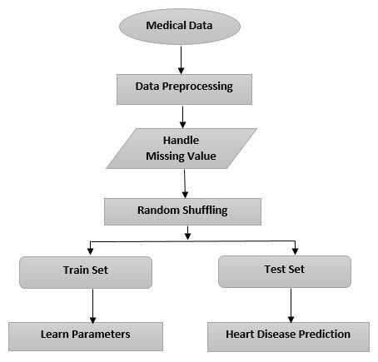
SYSTEM DESIGN
Design details – Architecture diagram
Fig 1. Heart Disease Prediction Model

Slide 9
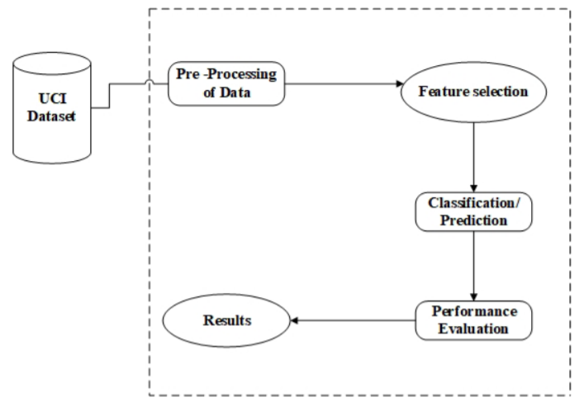
DETAILED DESIGN
Workflow Diagram
Fig 2. Experiment workflow with UCI dataset

Slide 10
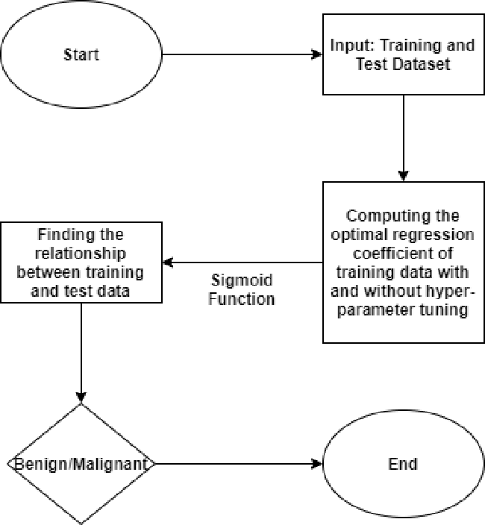
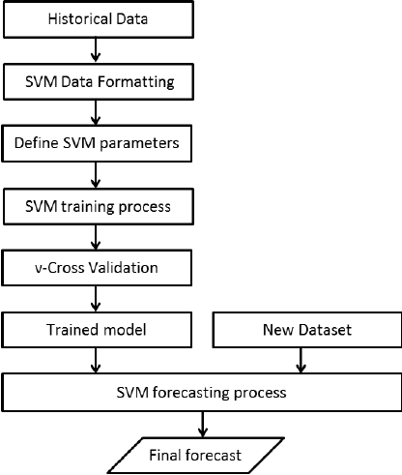
IMPLEMENTATION
Flow chart of Classification Algorithms
Fig 3.1 Flowchart of Logistic regression Fig 3.2 Flow chart of SVM

Slide 11
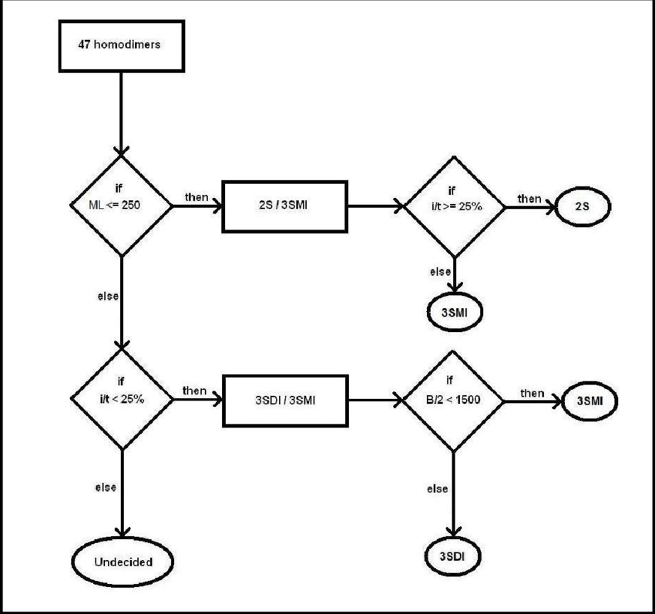
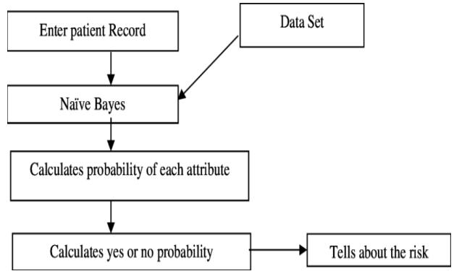
IMPLEMENTATION
Fig 3.3 Flow chart of Naive Bayes Fig 3.4 Flowchart of Decision Tree

Slide 12
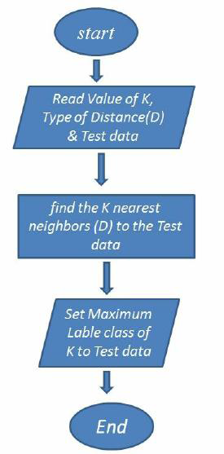
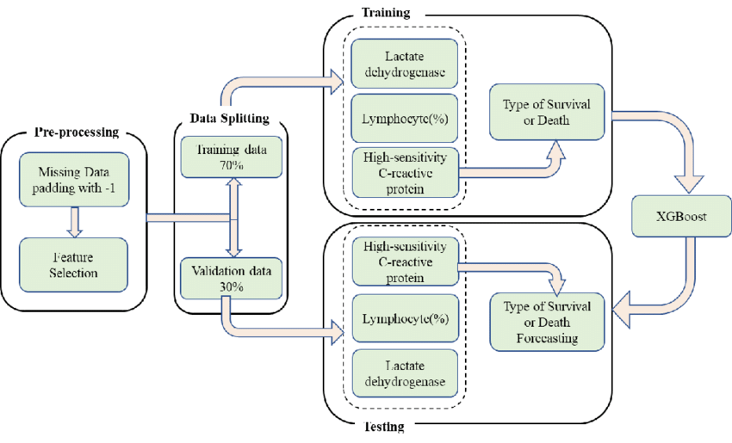
IMPLEMENTATION
Fig 3.5 Flowchart of
K Nearest Neighbour Fig 3.6 Flowchart of XG Boost

Slide 13
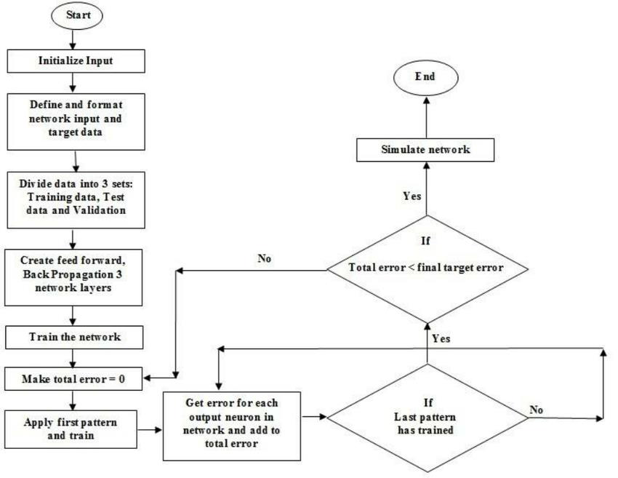
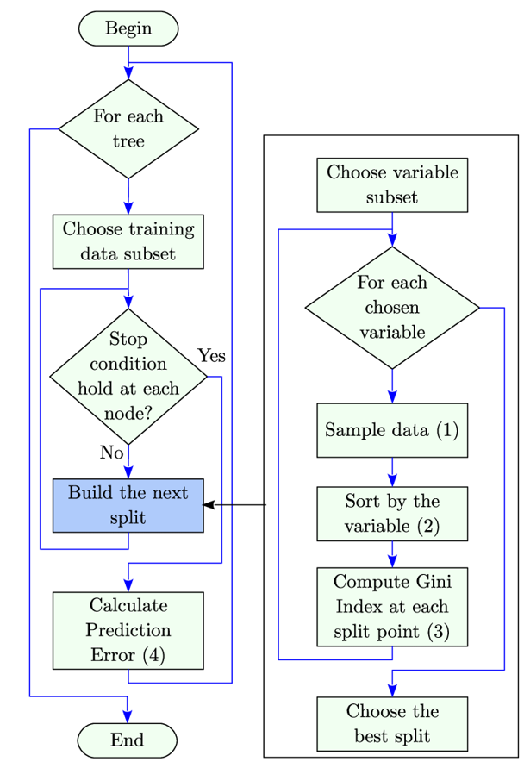
IMPLEMENTATION
Fig 3.7 Flowchart for Neural Network
Fig 3.8 Flowchart for Random Forest

Slide 14
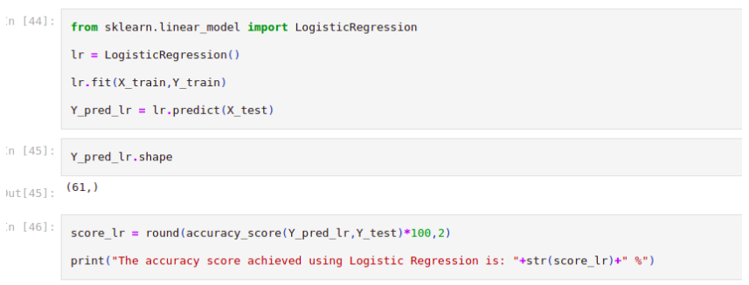
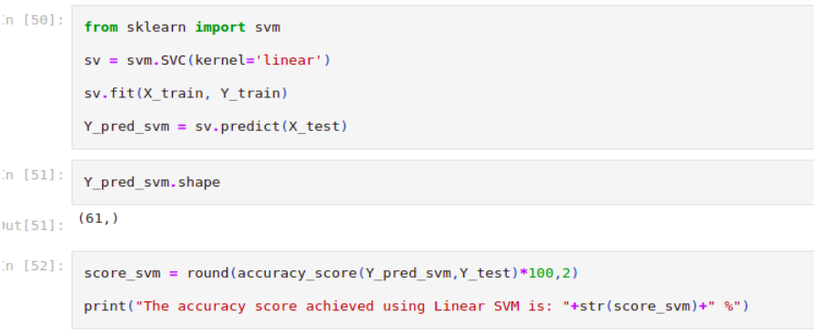
RESULTS
Logistic Regression
SVM
The accuracy score achieved is 85.25%
The accuracy score achieved is 81.97%

Slide 15
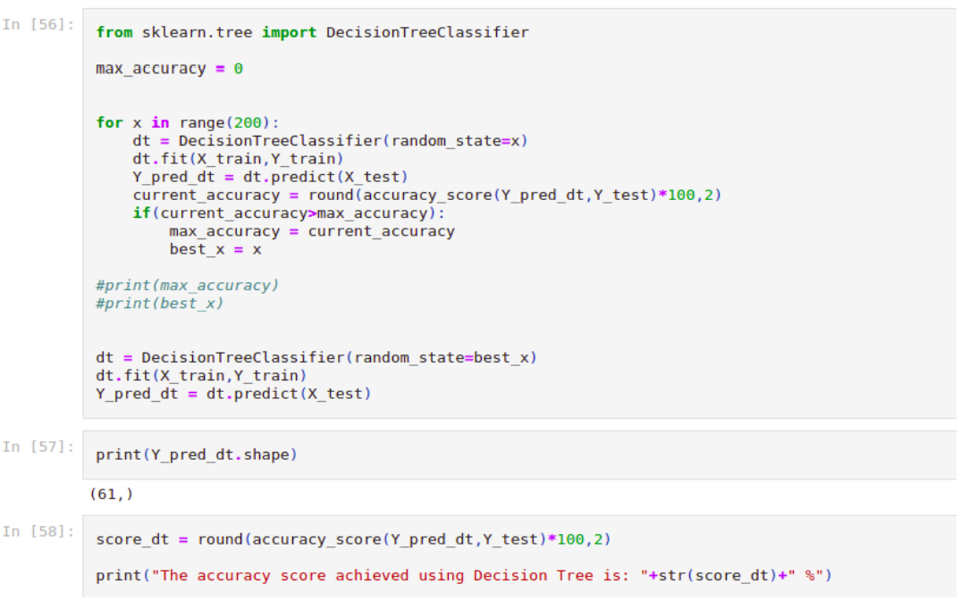
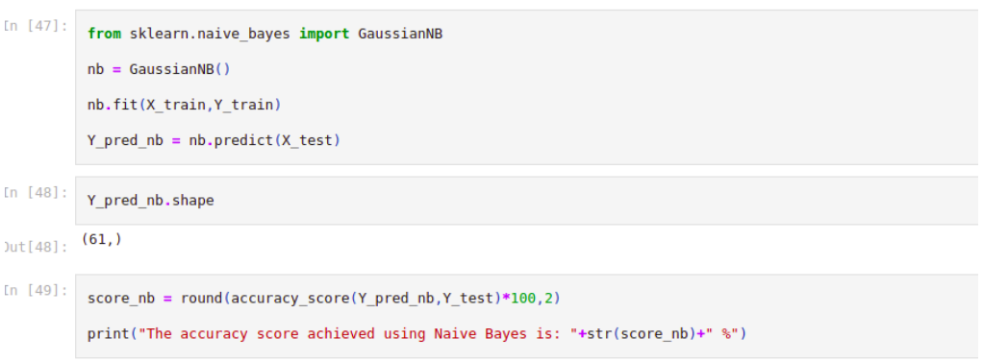
RESULTS
Naïve Bayes
Decision Tree
The accuracy score achieved is 85.25%
The accuracy score achieved is 81.97%

Slide 16
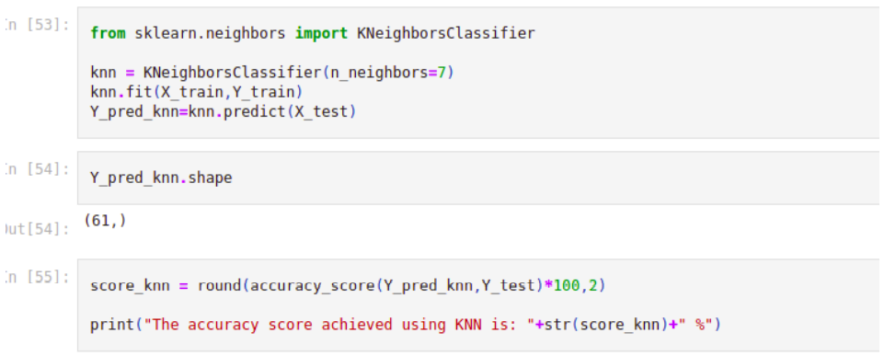
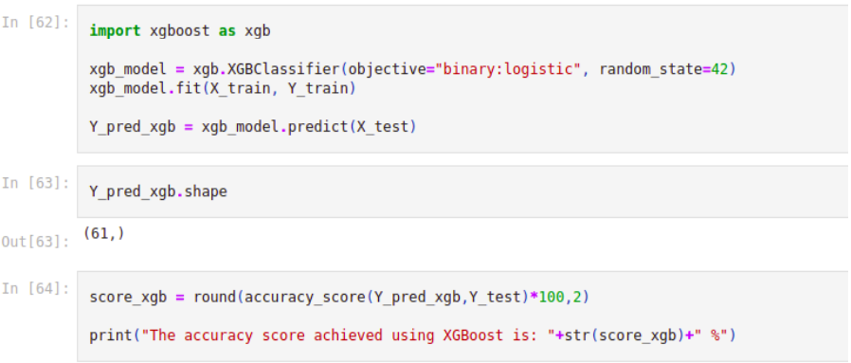
RESULTS
K-Nearest Neighbors
XG Boost
The accuracy score achieved is 67.21%
The accuracy score achieved is 85.25%

Slide 17
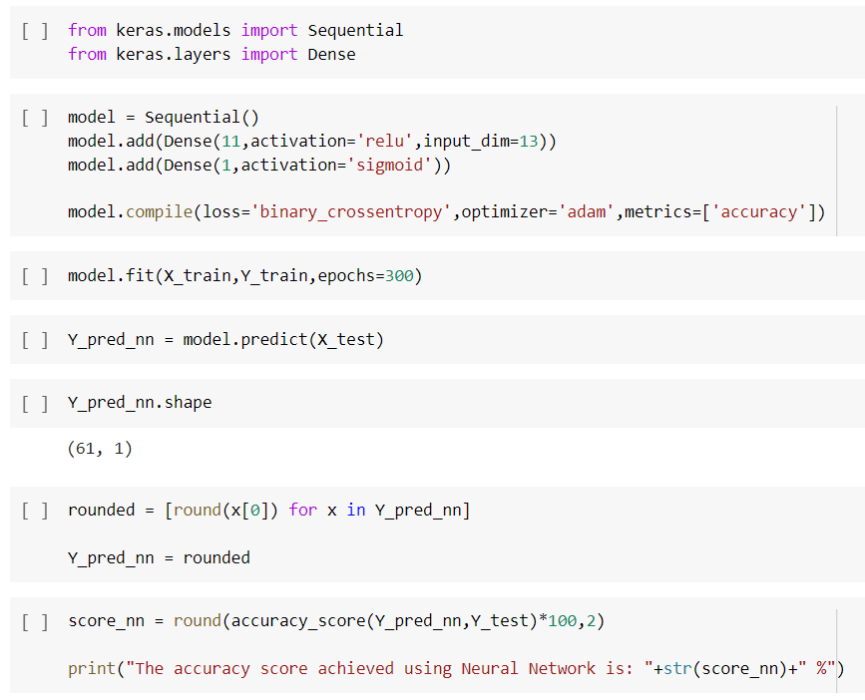
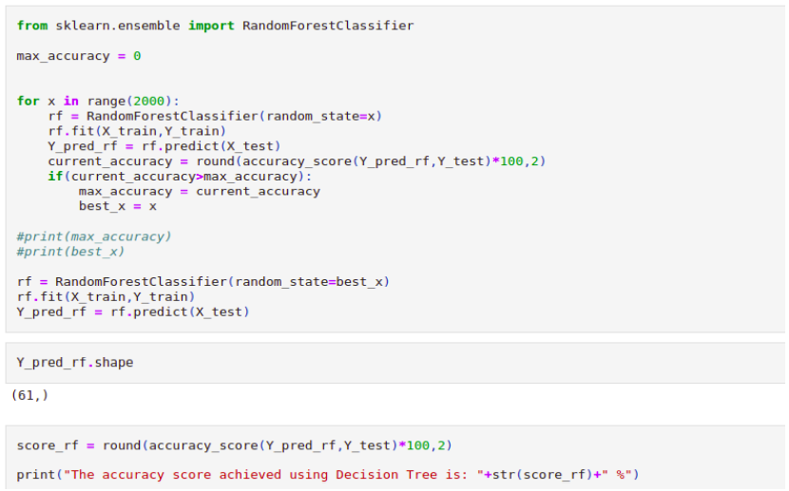
RESULTS
Neural Network
Random Forest
The accuracy score achieved is 83.61%
The accuracy score achieved is 90.16%

Slide 18
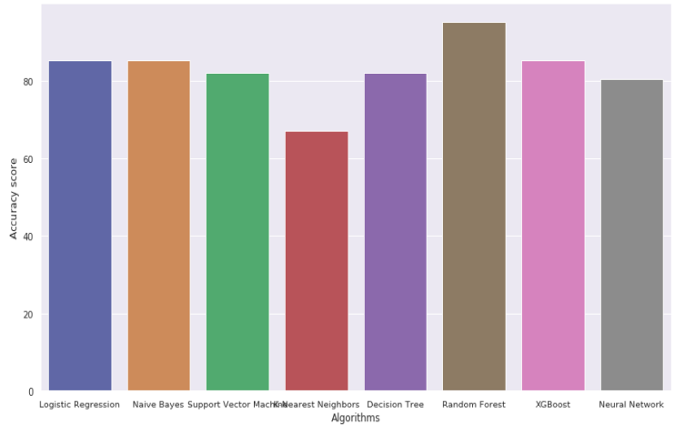
RESULTS
Accuracy Scores of all the Classification Algorithms are given below:
The accuracy score achieved using Logistic Regression is: 85.25 %
The accuracy score achieved using Naive Bayes is: 85.25 %
The accuracy score achieved using Support Vector Machine is: 81.97 %
The accuracy score achieved using K-Nearest Neighbors is: 67.21 %
The accuracy score achieved using Decision Tree is: 81.97 %
The accuracy score achieved using Random Forest is: 90.16 %
The accuracy score achieved using XGBoost is: 85.25 %
The accuracy score achieved using Neural Network is: 83.61 %
The above given graph depicts the accuracy scores of different algorithms

Slide 19
CONCLUSIONS
We conclude that to build an accurate heart disease prediction model, a dataset with sufficient samples and correct data must be used. The dataset must be preprocessed accordingly because it is the most critical part to prepare the dataset to be used by the machine learning algorithm and get good results. Also, a suitable algorithm must be used when developing a prediction model.
We can notice that Random Forest performed best, along with that, Artificial Neural Network (ANN) performed well in most models for predicting heart disease as well as Decision Tree (DT).
Finally, the field of using machine learning for diagnosing heart disease is an important field, and it can help both healthcare professionals and patients.

Slide 20
FUTURE ENHANCEMENTS
The performance of the health’s diagnosis can be improved significantly by handling numerous class labels in the prediction process, and it can be another positive direction of research.
In future an intelligent system may be developed that can lead to selection of proper treatment methods for a patient diagnosed with heart disease.
As we have developed a generalized system, in future we can use this system for the analysis of different data sets.

Slide 21
REFERENCES
[1] N. Khateeb and M. Usman, “Efficient heart disease prediction system using k-nearest neighbor classification technique,” in Proceedings of the International Conference on Big Data and Internet of Thing (BDIOT), New York, NY, USA: ACM, 2017, pp. 21–26.
[2] J. Soni et al., “Intelligent and effective heart disease prediction system using weighted associative classifiers,” International Journal on Computer Science and Engineering, vol. 3, no. 6, pp. 2385–2392, 2011.
[3] H. Almarabeh and E. Amer, “A study of data mining techniques accuracy for healthcare,” International Journal of Computer Applications, vol. 168, no. 3, pp. 12–17, Jun 2017.
[4] M. Fatima and M. Pasha, “Survey of machine learning algorithms for disease diagnostic,” Journal of Intelligent Learning Systems and Applications, vol. 9, no. 01, pp. 1–16, 2017.
[5] S. Pouriyeh et al., “A comprehensive investigation and comparison of machine learning techniques in the domain of heart disease,” in Proceedings of IEEE Symposium on Computers and Communications (ISCC). Heraklion, Greece: IEEE, July 2017, pp. 204–207

Slide 22
Question and Answer

Slide 23
THANK YOU

